Slide 1
Using Splunk to Improve Your Network Security Posture
Andrew Wurster
Network Consulting Engineer,
Cisco

Slide 2
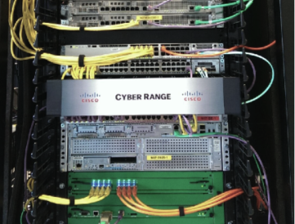
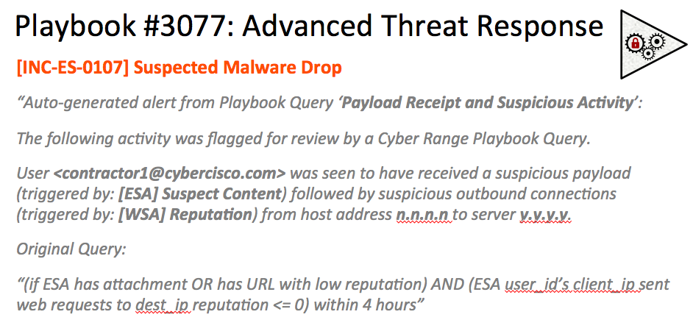




Session Agenda
Crash Course: Securing Your Network
Core Technologies and Concepts
Hands On: Scenarios, Playbook Queries
WWW

Slide 3
Crash Course: Securing Your Network

Slide 4
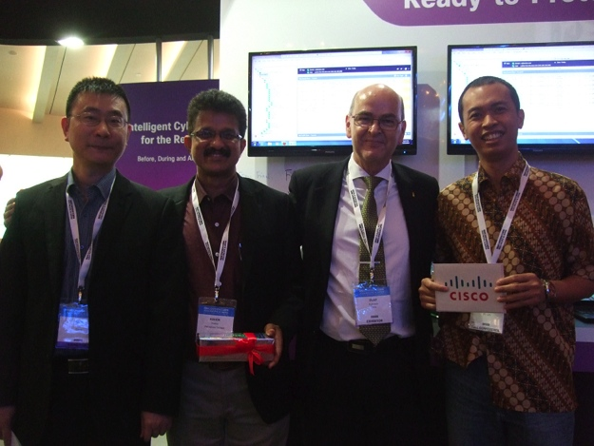
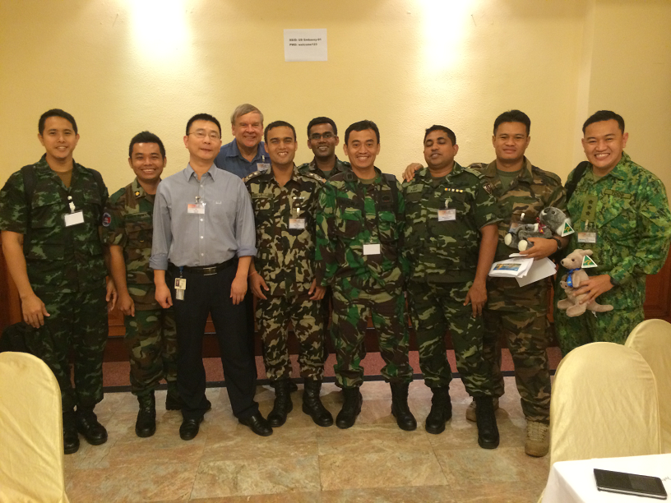
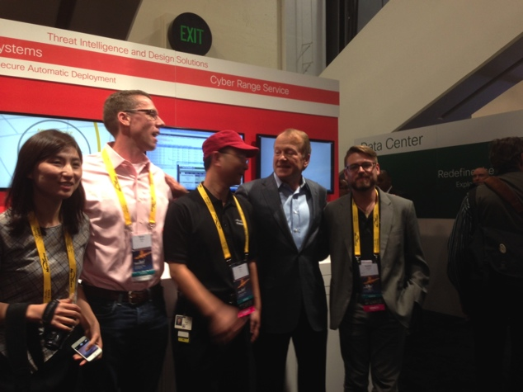
Some History on our Cyber Range

Slide 5
Follow the Pros: Cisco's Incident Response Team
2 billion events / day collected in Splunk
4 billion DNS records
/ day
22TB of traffic inspected / day
1% blocked as Malware
automatically by WSAs
750GB of logs collected / day
6 million HTTP transactions
/ day handled by WSAs
13 billion
NetFlow Records
/ day
proven architecture and processes
12 Critical DCs in Production
Over 400 Application Service Providers

Slide 6





R&D by Cisco's Professional Services
2 x Search Heads
Mirrored Dev Servers
1 x Indexer
Index Forwarding
Cyber Range
“Live” Inside Network
Scripted Input HTTPS
syslog
TCP/UDP
eStreamer (sFIRE)
Mail Logs
(ESA)
WWW
Access Logs
(WSA)
SDEE
(IPS)
Syslog
(ASA, ISE, etc)

Slide 7
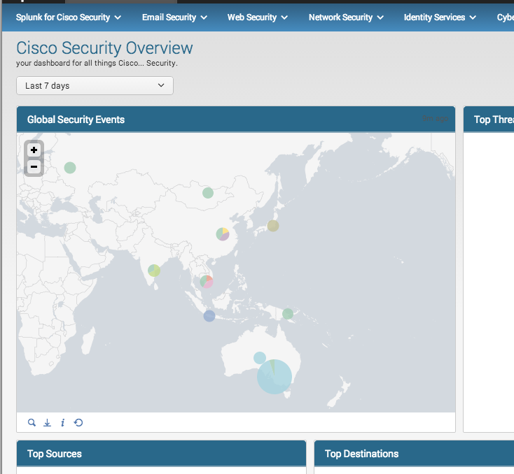
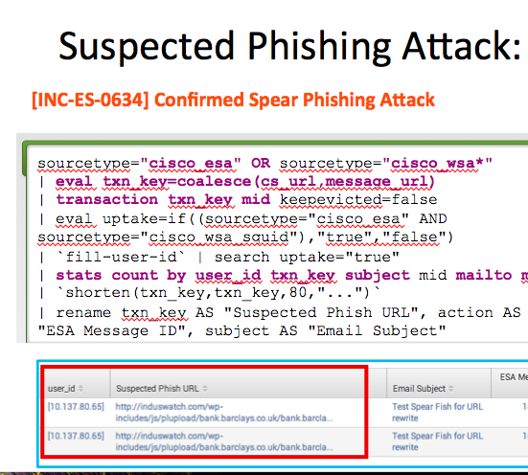
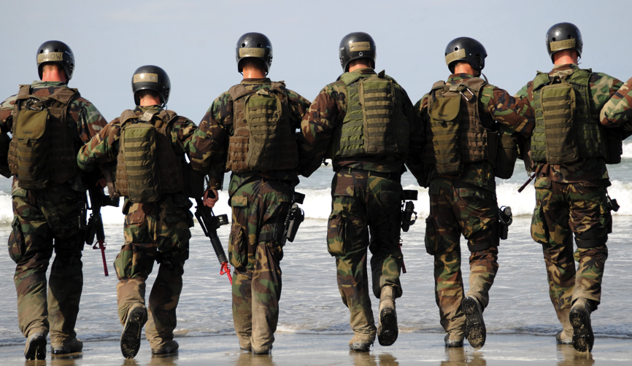
The Journey Starts Here, Today.
Incident Response Playbook
Understand your data
Feedback Loop
"Trial by fire"
Build your arsenal

Slide 8
Core Components and Technologies

Slide 9
Key Areas of Information to Investigate
Authentication and Authorization
System and Data Changes
Network Activity
Resource Access
Malware Activity
Failure and Critical Errors
Source: SANS Top 6 Categories of Critical Log Information
Notes:
Top Report Categories from SANS:
Authentication and Authorization Reports
All login failures / successes by user, system, and BU
Login Attempts (success and failure) to non standard accounts: disabled / service / non-existent / default / suspended
All logins after hours
Auth failures by unique attempted systems
VPN auth and remote logins (success and failure)
Privileged account access (success and failure)
Multiple login failures followed by a success (same account)
Systems and Data Change Reports
CRUD for users, groups
Additions of accounts to admin / high priv groups
Password changes / resets – by users and on behalf of them
CRUD for network services (new process IDs, local network conns, etc)
Change to system files, binaries, configs (host IDS)
Changes to custom / other key files
Changes to file access permissions
Application installs and updates (success, failure) by system, app, user
Network Activity Reports
All outbound conns from internal / DMZ systems – by system, conn count, user, bandwidth, unique destinations
“” during off hours
Top largest file transfers (inbound, outbound) OR top largest sessions by bytes xferred
Web file uploads to external sites (proxy logs)
All file downloads by content type (exe, dll, scr, etc) and protocol (HTTP, email, IM, etc)
Internal systems using many different protocols, ports (anomalous)
Top internal systems as sources for multiple NIDS, NIPS, WAF alerts
VPN network activity by user name, total session bytes, session count, resource usage
P2P use by internal system (AUP from web logs / next gen firewall)
Wireless network activity (devices, users, etc) – may also want to do “off hours” access
Log volume trend over days
Resource Access Reports
Access to resources on critical systems after hours
Top internal users blocked by proxy from accessing prohibited sites, malware sources, etc
File, network share or resources access (success, failure)
Top database users (should be service accounts, not developers ideally)
Summary of DB query types
Privileged DB user access
All users executing insert, delete commands on DB
All users executing create, grant, schema changes on DB
Summary of DB backups
Top internal email addresses sending attachments to outside
All emailed attachment content types, sizes, names (may want users too…)
Top internal systems sending mail excluding known mail servers
Log access summary
Malware Activity Reports
Malware detection trends w outcomes (is it getting blocked or not?)
Detect-only events from AV tools (stuff not cleaned or scanned)
All AV protection failures (crashes, update failures, etc)
Internal conns to known malware IP addresses
Least common malware types (bottom 10 versus top 10)
Failure and Critical Error Reports
Critical errors by system, app, business unit
System and app crashes, shutdowns, restarts
Backup failures
Capacity / limit exhaustion events for memory, disk, CPU, other resources

Slide 10
Key Technologies
Anomaly Detection
IDS
What type of Threat
can each tool detect?
DLP
Anti-Virus
Anti-Malware
HIPS
IDS
Command & Control Traffic
Infected Host

Slide 11
Filling those Core Competencies from the Network
SANS Competencies | Technologies | Sources, Patterns, and Indicators
Authentication, Authorization |  | Login Activity, Time Spent, Privileges, Endpoint Posture, AAA Logs, Directory Logs ...
System, Data Changes |  | File Hashes, AAA Logs, Host IDS, Change Records, ...
Network Activity |  | Netflow Stats, Firewall Conns, Proxy Logs, IDS Events, DNS Logs, Time Spent...
Resource Access |  | Email Stats, Proxy Logs, Netflow Stats, Endpoint Posture, Directory Logs, ...
Malware Activity |  | File Downloads, Email Attachments, Firewall Conns, Malware Engine Scans, ...
Failure, Critical Errors |  | ... etc ...
WWW
WWW
WWW
Switches, Routers, APs
NGFW / NGIPS
Web Proxy
Mail Gateway
AAA Server
Netflow Analyzer
Firewall
WWW

Slide 12
Input and Source Types
Device Class | Input Method | Protocols | Sample
ASA Firewall | Network | Syslog | Jul 02 2014 23:14:06: %ASA-5-106100: access-list inbound denied tcp outside/193.201.30.23(135) inside/193.201.30.23(1922) hit-cnt 1 first hit [0x91c26a3, 0x0]
Email Security Appliance | File / Network | SCP / FTP / Syslog | Thu Jul 02 23:15:54 2014 Info: MID 245170 Message-ID '<194961.85741.qm@web65710.mail.ac4.yahoo.com>'
Web Security Appliance | File / Network | SCP / FTP / Syslog | 1343913291.98 70 91.208.184.24 TCP_MISS/200 3454 GET http://www.flashgames247.com/thumb/80x70/images/ …
Cisco IPS | Scripted Input | HTTPS (SDEE) | 2014-07-02 17:58:34,670 - INFO - 1343894300486157000 eventid="6821322601693" hostId=”ips.acme" sig_created="20061120" sig_type="other" severity="informational" app_name="sensorApp" appInstanceId="1588" signature="5575” …
Generic IOS | Network | Syslog | Jul 2 23:24:20 10.48.24.32 Aug 2 2014 13:24:20 ace.acme: %ACE-3-251008: Health probe failed for server 192.168.111.12 on port 443 …
WWW

Slide 13
Input and Source Types
Device Class | Input Method | Protocols | Sample
Sourcefire | Scripted Input | HTTPS (eStreamer) | rec_type=400 rec_type_simple="IPS EVENT" event_sec=1409300614 event_usec=919489 sensor=10.67.34.71 event_id=258025 msg="APP-DETECT failed FTP login attempt" sid=13360 gid=1 rev=6 class_desc="Misc Activity" class=misc-activity priority=low src_ip=192.168.100.98 dest_ip=192.168.10.18 …
Cyber Threat Defence (Lancope) | Network | Syslog | Aug 29 17:59:00 stl-as-n07-cyber-smc-1.cisco.com Aug 29 16:59:00 stl-as-n07-cyber-smc-1 StealthWatch[2359]: alarm_category_name="Anomaly", alarm_severity_name="Major", alarm_status="ACTIVE", alarm_type_name="High Target Index", …
Wireless LAN Controller | Network | Syslog | Aug 30 13:55:28 n07-3850-1-wlc.cisco.com 47920: 0.0.0.0: Aug 30 03:59:02.892: %EPM-6-POLICY_APP_SUCCESS: Policy Application succeded for Client [0.0.0.0] MAC [40f3.0868.59d5] AuditSession ID [0a43223754014c0600007e44] for POLICY_TYPE [URL Redirect] …
Cisco ISE / TrustSec | Network | Syslog | Aug 31 15:08:13 stl-as-n07-ise-1.cisco.com Aug 31 15:08:14 stl-as-n07-ise-1 CISE_Passed_Authentications ... NOTICE Passed-Authentication: Authentication succeeded, ConfigVersionId=7, Device IP Address=10.67.34.55, DestinationIPAddress=10.67.34.38,…

Slide 14
Primer on the Common Information Model …
Assumes you have all the proper "piping" in place
App tries to set structure up for you, but may take some fine tuning
Event types built on "cisco:<*>:<*>" source typing logic:
eventtype=cisco-wsa-squid
[cisco-wsa-squid]
search = sourcetype="cisco:wsa:squid"
CIM Compliant Event Types, Tags work across apps, i.e. Splunk ESS
Common Info Model Add-on helps identify any missing gaps
Splunk.com > Documentation > Splunk Common Information Model Add-on > Common Information Model Add-on Manual > Overview
http://docs.splunk.com/Documentation/CIM/latest/User/Overview
Notes:
References

Slide 15
A Simple Example using CIM
Aug 02 2014 23:14:06: %ASA-5-106100: access-list inbound denied tcp outside/173.246.103.92(1922) inside/192.168.10.18(135) hit-cnt 1 first hit [0x91c26a3, 0x0]
Source
src_ip
173.246.103.92
Metadata
src_port
1922
sourcetype
cisco:asa
host
asa5585-2
src_if
outside
_time
Aug 02 2014 …
…
…
source
syslog_tcp
Destination
eventtype
firewall_deny
Outcome
dest_ip
192.168.10.18
…
…
action
blocked (“denied”)
dest_port
135
cause
Firewall Drop
dest_if
inside
direction
inbound
…
…
…
…

Slide 16
Using CIM to Correlate
action
dropped
cause
Firewall Drop
Aug 02 2014 23:14:06: %ASA-5-106100: access-list inbound denied tcp outside/173.246.103.92(1922) inside/192.168.10.18(135) hit-cnt 1 first hit [0x91c26a3, 0x0]
direction
inbound
src_ip
173.246.103.92
query_id=“SPL-MW-003-05”
query_description=“Inbound Scan w/ Outbound Access” incident_id=“1115258_0800_20-Aug-14” attacker_ip="173.246.103.92" severity=“med”
sourcetype="cisco:wsa,cisco:asa" _time=“20 Aug 2014”
raw_event=“<Firewall Event> … <Web Sec Event> …”
src_ip
OR
dest_ip
173.246.103.92
action
allowed (HTTP/200)
1409754862.736 33628 192.168.10.18 TCP_MISS/200 4333 TCP_CONNECT 173.246.103.92:8443 …
173.246.103.92 "Computer Security" 1028
cause
Acceptable Use
direction
outbound
dest_ip
173.246.103.92

Slide 17
Hands' On: Playing with Playbooks

Slide 18

Getting Started with Your Own Playbook
Building a playbook is a practical way to dealing with Security Incidents
Focus on 3 sections of SANS’ Top 6 Log Categories
2 queries per category:
Resource Access Reports
Network Activity Reports
Malware Activity Reports
Real queries *you* can take back home to work and use
Role-playing to make listening slightly more enjoyable less painful
Assumes you have apps and sources all pre-configured

Slide 19




Understanding the Guides
Questions posed like mock tickets
Some non-essential commands omitted for readability
eval, rex, rename ...
Cisco-specific event types, key points highlighted in red
Key fields highlighted in blue
Most should be CIM compliant / easily transferred to other sourcetypes
Queries can be copied directly
Online code has some added tweaks
As part of our ongoing audit from the CSIRT office, we need to generate a new report to uncover suspected malware infections across our network.
From the SANS Logging Best Practices guide, we need to capture the following:
Vance Lions
Lead Server Architect
Eastern EU
Resource Access: RA-WEB-01
Chart View
eventtype=cisco-wsa-squid action=block OR action=error
| eval cs_username=if(isnull(cs_username) OR cs_username ...

Slide 20
Primer: Resource Access
Focus on WHO is accessing WHAT resources – obtaining attribution.
Can grab this info from a variety of sources! (AAA, Proxy, FW/IDS ...)
Some Resource Access Reports we’ll focus on:
Top internal users blocked by proxy from accessing prohibited sites, malware …
can be used for multiple purposes from tracking compromised systems to the data leakage tracking to improved productivity.
Top internal email addresses sending attachments to outside
a basic way to find systems infected with spam-sending bots across your environment.

Slide 21


Resource Access: RA-WEB-01
[INC-SPL-0001] Create new playbook query for blocked proxy users
As part of our ongoing audit from the CSIRT office, we need to generate a new report to uncover suspected malware infections across our network.
From the SANS Logging Best Practices guide, we need to capture the following:
Top internal users blocked by proxy from accessing prohibited sites, malware
Vance Lions
Lead Server Architect
Eastern EU

Slide 22

Resource Access: RA-WEB-01
[INC-SPL-0001] Create new playbook query for blocked proxy users
Chart View
eventtype=cisco-wsa-squid action=block OR action=error
| eval cs_username=if(isnull(cs_username) OR cs_username="-","[" + c_ip + "]",cs_username) | top cs_username
Detailed View
eventtype=cisco-wsa-squid action=block OR action=error
| eval cs_username=if(isnull(cs_username) OR cs_username="-","[" + c_ip + "]",cs_username) | stats values(dest_domain) count by cs_username, action, cause

Slide 23
Resource Access: RA-EMAIL-01
[INC-SPL-0002] Create new playbook query for email attachments
As part of our ongoing audit from the CSIRT office, we need to generate a new report to uncover systems infected with spam-sending bots across our environment.
From the SANS Logging Best Practices guide, we need to capture the following:
Top internal email addresses sending attachments to outside
Vance Lions
Lead Server Architect
Eastern EU

Slide 24
Resource Access: RA-EMAIL-01
[INC-SPL-0002] Create new playbook query for email attachments
Chart View
eventtype=cisco-esa
| transaction mid | where isnotnull(attachment_name)
| top sender
Detailed View
eventtype=cisco-esa
| transaction mid | where isnotnull(attachment_name)
| stats dc(recipient) dc(mid) by sender message_subject attachment_name message_size

Slide 25
Primer: Network Activity
Focus on WHAT sort of traffic is traversing your network.
Can grab this info from a variety of sources! (AAA, Wireless, netflow ...)
Some Network Activity Reports we’ll focus on:
All outbound connections from internal and DMZ systems by system, connection count, user, bandwidth, count of unique destinations
tracking who is connecting from your network ... to detect intrusions, compromises, malicious software, users abusing network access
Wireless network activity logs
track access (with username or Windows name) via wireless networks to trace connection times, source MAC and client IP.
Notes:
BONUS: Can easily pivot here for another search!!! Top largest file transfers (inbound, outbound) OR top largest sessions by bytes xferred
BONUS: Easy overlays include Rogue AP detection / assoc., normal business hours

Slide 26

Network Access: NW-CONNS-01
[INC-SPL-0003] Audit Outbound Connections
As part of our ongoing audit from the CSIRT office, we need to generate a new report to audit outbound connections from our Internal / DMZ networks.
From the SANS Logging Best Practices guide, we need to capture the following:
All outbound connections from internal and DMZ systems by system, connection count, user, bandwidth, count of unique destinations
Ain Gnobadi
Junior SOC Engineer
Americas

Slide 27
Network Access: NW-CONNS-01
[INC-SPL-0003] Audit Outbound Connections
Chart View
eventtype=cisco-wsa | eval user_id=if(isnull(cs_username) OR cs_username="-" OR isnull(user_id),"[" + c_ip + "]",user_id) | timechart dc(cs_url_host) by user_id
Detailed View
eventtype=cisco-wsa | stats sum(bytes_out) sum(bytes_in) sum(duration) AS conn_time by user_id, dest_domain

Slide 28
Network Access: NW-WIFI-01
[INC-SPL-0004] Audit Wireless Activity
As part of our ongoing audit from the CSIRT office, we need to generate a new report to audit all wireless user activity to detect anomalies and abuse across our campus.
From the SANS Logging Best Practices guide, we need to capture the following:
Track all access (username or Windows name) via wireless networks to trace connection times, source MAC and client IP
Ain Gnobadi
Junior SOC Engineer
Americas

Slide 29
Network Access: NW-WIFI-01
[INC-SPL-0004] Audit Wireless Activity
Chart View
sourcetype="cisco:ise:syslog" log_type="passed_authentications" | dedup Calling_Station_ID | top EndPointMatchedProfile
Detailed View
eventtype=cisco-wlc (DUPADDR OR *AUTH* )
| stats values(src_ip) dc(src_ip) by src_mac

Slide 30
Primer: Malware Activity
Focus on Malicious traffic or indicators of compromise
Can grab this info from a variety of sources! (Proxy, NGFW, netflow ...)
Some Malware Activity Reports we’ll focus on:
Malware detection trends with outcomes
i.e - is it getting blocked or not?
Internal connections to known malware IP addresses
locate high fidelity indicators of compromise.

Slide 31

Malware Activity: MW-TREND-01
[INC-SPL-0005] Create new playbook query for malware trends
As part of our ongoing audit from the CSIRT office, we need to generate a new report to follow types and rates of Malware detected within our environment.
From the SANS Logging Best Practices guide, we need to capture the following:
Malware detection trends with outcomes
Omar Kymark
HR Liason
Hong Kong
31

Slide 32
Malware Activity: MW-TREND-01
[INC-SPL-0005] Create new playbook query for malware trends
Chart View
eventtype=cisco-wsa-squid | eval result=action + ": " + cause | timechart usenull=f count by result
Detailed View
eventtype=cisco-wsa-squid
| stats count by action, cause
| sort –count
32

Slide 33
Malware Activity: MW-CONNS-01
[INC-SPL-0006] Create new playbook query for malware connections
As part of our ongoing audit from the CSIRT office, we need to generate a new report to track outbound connections towards known Malware servers from our internal networks.
From the SANS Logging Best Practices guide, we need to capture the following:
Internal connections to known malware IP addresses
Omar Kymark
HR Liason
Hong Kong
33

Slide 34
Malware Activity: MW-CONNS-01
[INC-SPL-0006] Create new playbook query for malware connections
Chart View
sourcetype=cisco_wsa*
| lookup threatscore clientip AS dest_ip
| fillnull value="" threatscore, x_wbrs_score | where threatscore>0 OR x_wbrs_score<-2.0
| top dest_ip
Detailed View
sourcetype=cisco_wsa*
| lookup threatscore clientip AS dest_ip
| fillnull value="" threatscore, x_wbrs_score | where x_wbrs_score<-2.0
| stats values(eventtype) count by src_ip, dest_ip, action, threatscore, x_wbrs_score
34

Slide 35
Wrap Up

Slide 36
Jumpstart Your Own Journey
Incident Response Playbook
Understand your data
Feedback Loop
"Trial by fire"
Build your arsenal

Slide 37
Session Recap
Effective SIEM should be a journey, not a destination
You don't always need the latest and greatest detection technologies
Tools are only as effective as their Human Masters
Keep your data organized and tidy to save time, heartache later on
Having strong processes and procedures in place can be better than even the best Splunk app or search
Whatever your favorite approach is – pick one and stick to it!

Slide 38
Solution Guides and Code
All examples and code seen today are online. Check it out!
https://github.com/awurster/Splunk-.conf-2014

Slide 39



Keeping in Touch
Find me on Linked
me: awurster@cisco.com
Check out my
Repositories

